Slide 1

Exploratory Data Analysis on
AMCAT Data
By
Koushik Katakam
IN1242004

Slide 2
About me
Background ?
I am Koushik Katakam completed Mtech in 2022 Information Technology(Data Sciences) in
Cvr College of Engineering
Why you want to learn Data Science
I want upskill myself and be there in a good position in future and should able to solve challenging tasks
Any work experience
I Worked as a ‘Php Developer for 10 months in Ceipal Software pvt ltd’
Share your linkedIn and github profile urls
linkedIn : https://www.linkedin.com/in/koushik-katakam/
github : https://github.com/koushikkatakam

Slide 3
Problem statement:
Analysis AMCAT test data point to identify certificate performance trends ,strength and weakness job selection processes often lead to mismatches between candidates and positions, resulting in decreased productivity and increased turnover. This project aims to streamline the job selection process by identifying key criteria for successful optimize the use of AMCAT scores in the hiring candidate evaluation and implementing strategies to improve the efficiency and effectiveness of the selection process, ultimately enhancing organizational performance and employee satisfaction.
Objective of the Project:
To develop and implement a comprehensive job selection framework that enhances the efficiency, fairness, and effectiveness of the recruitment process. This framework should include standardized criteria for evaluating candidates, streamlined procedures for application and assessment, and tools for ensuring alignment between candidates' skills and organizational needs. The ultimate goal is to optimize hiring outcomes by selecting candidates who are best suited for the roles and contribute positively to the organization's success."

Slide 4
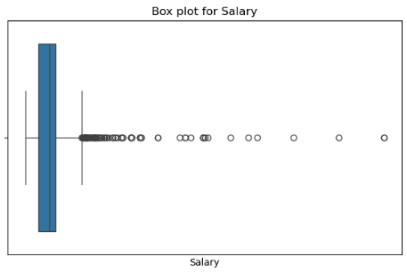
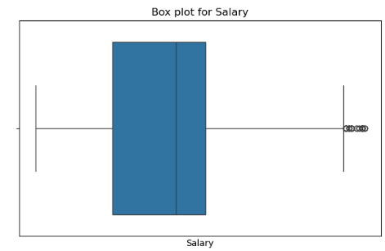

Data Cleaning Steps
Handling outliers
Before outliers
Handle Duplicates
Removing Outliers
Cleaning column values
Converting to proper data types
After outliers

Slide 5
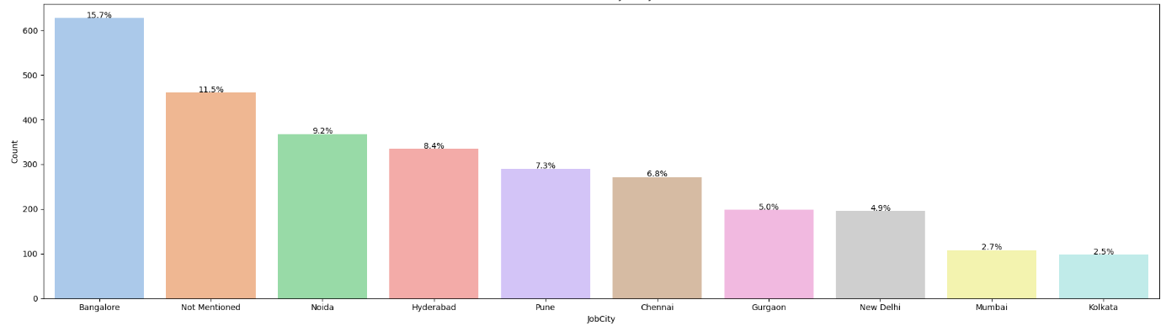
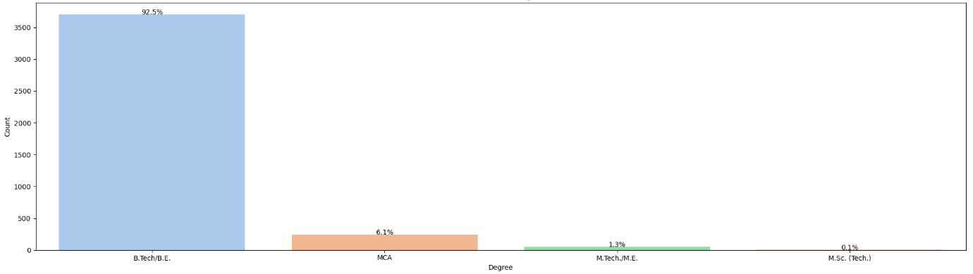
Univariate - Visual Analysis (Categorical Column)
This plot only shows top ten Job Cities.
Most of the students got job in Bangalore followed by Noida and Hyderabad.
Almost 11.5% students who are employed are Not Mentioned their Job City
Most of the students have their Degree is Btech with almost of 92.5% followed by MCA, M.Tech/M.E and M.Sc

Slide 6
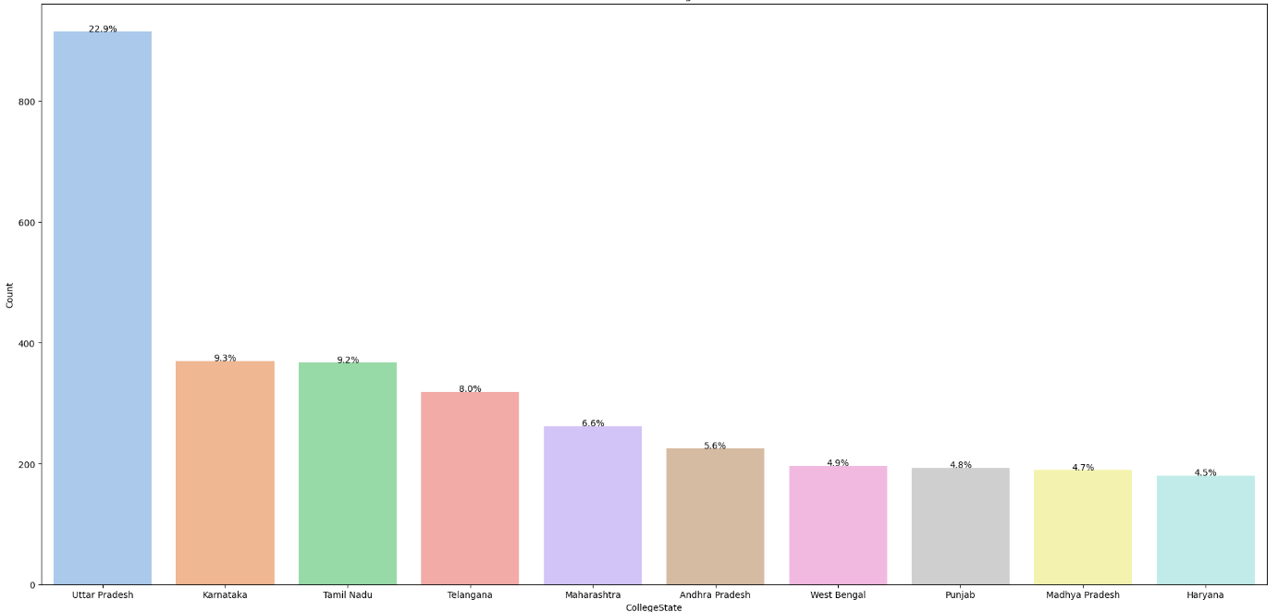
Univariate - Visual Analysis (Categorical Column)
This plot contains only top 10 CollegeState among many of them.
Most of the students are from Uttar Pradesh with 22.9% followed by karnataka with 9.3% followed by Tamilnadu 9.2% so on

Slide 7
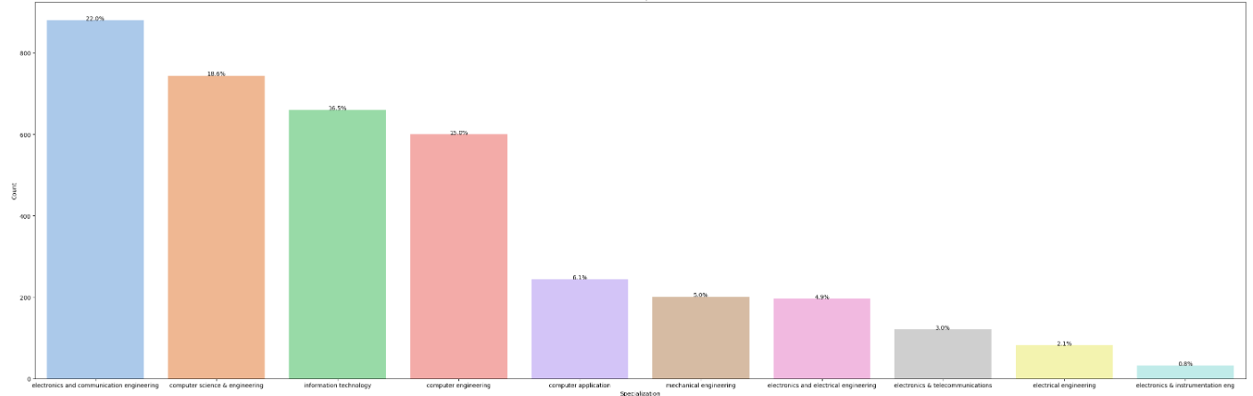
Univariate - Visual Analysis (Categorical Column)
This plot contains only top 10 Specializations among many of them.
Most of the students with Degree Specialization is electronics and communication engineering with 22% followed by computer science and engineering with 18.6%, Information Technology with 16.5%

Slide 8
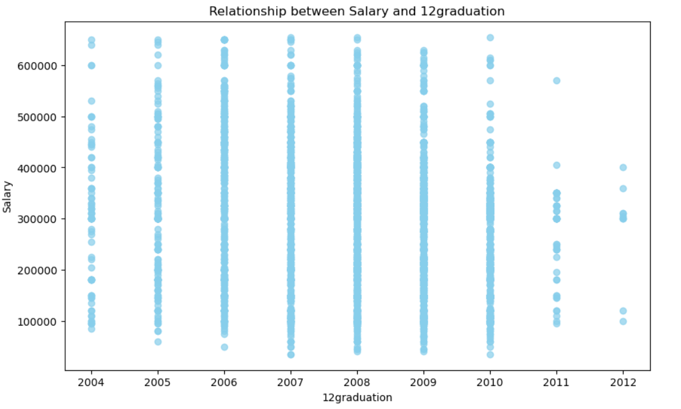
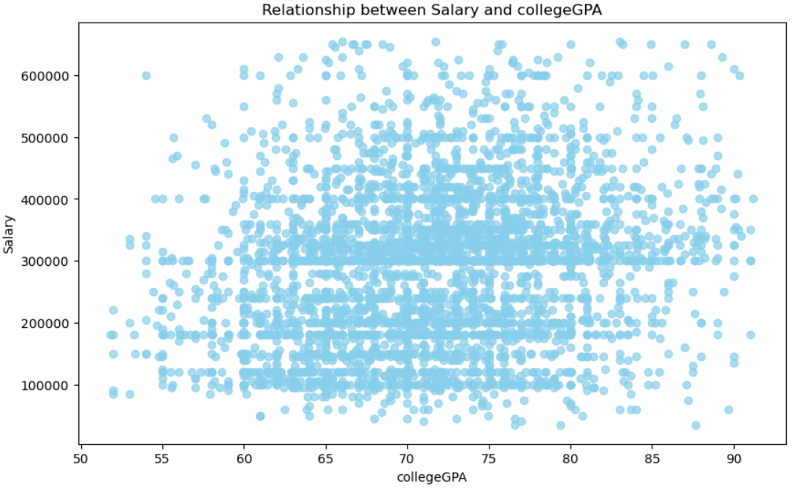
Bivariate analysis (numerical vs numerical)
2004 to 2010 12th graduation students have packages from 1lac to 6lac.
2012 graduation students are rarely got job that means data may not be there or who are 2012 12th passedout students are not employed in software industry
who have 50 to 60 Degree Percentage have got rarely above 4lac package.
who have 60 to 85 Degree percentage have got package from 1lac to 4lac and rarely 5 to 6lac package

Slide 9
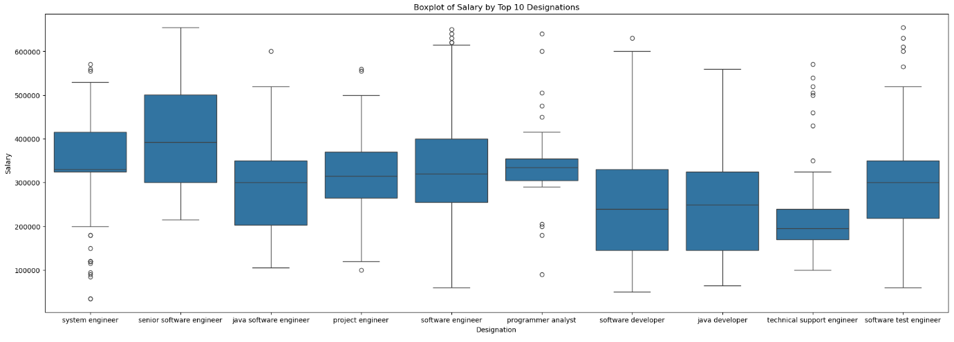
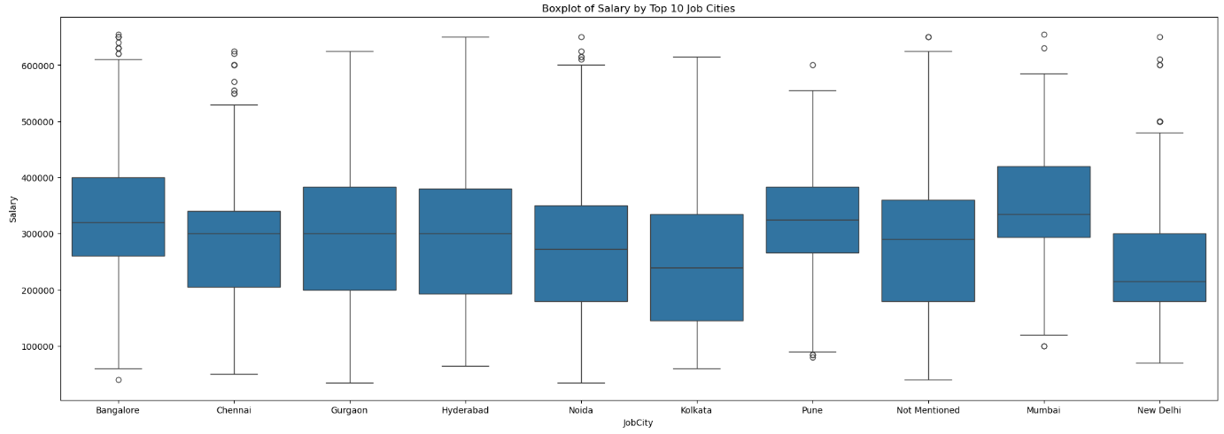
Bivariate analysis (numerical vs numerical)
Employees with Designation of senior software engineer have more salaries followed by system engineer.
Employees with Designation of technical support engineer have less salaries.
Employees who are in Mumbai and Bangalore having highest salaries.
Employees who are in New Delhi and kolkata have less salaries

Slide 10
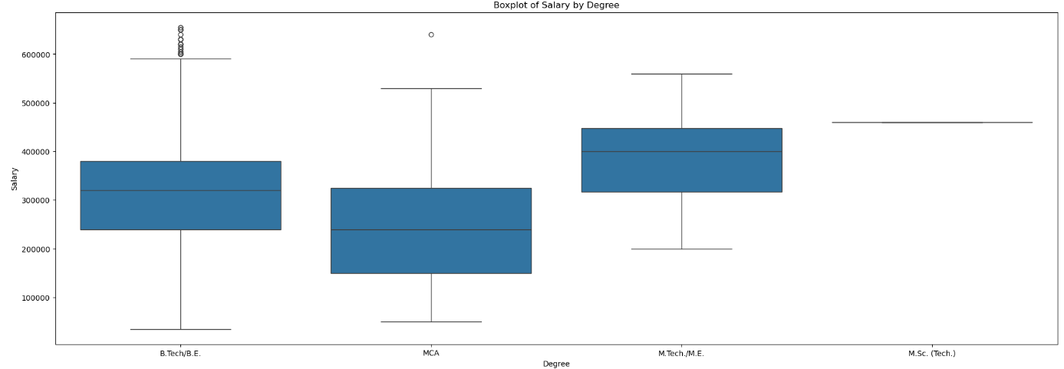
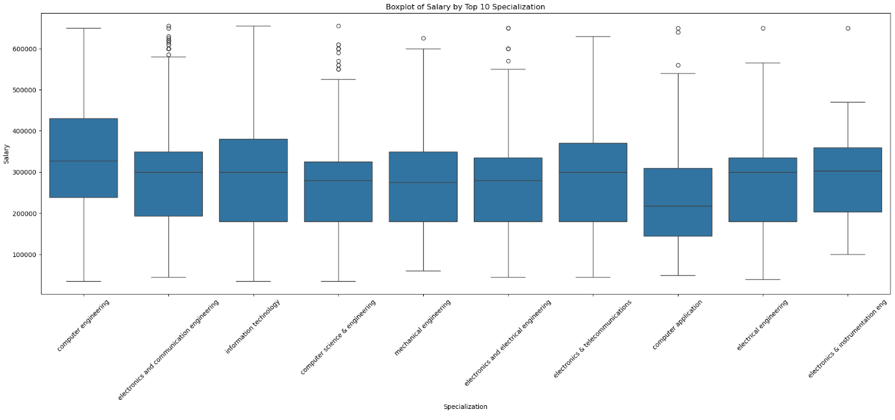
Bivariate analysis (numerical vs numerical)
Mtech/ME people having more salaries followed by Btech and MCA and MSc.
MCA people have less salaries comparing to others.
Employees with computer engineering specilization have more salaries.
Employees with computer application specialization have less salaries

Slide 11
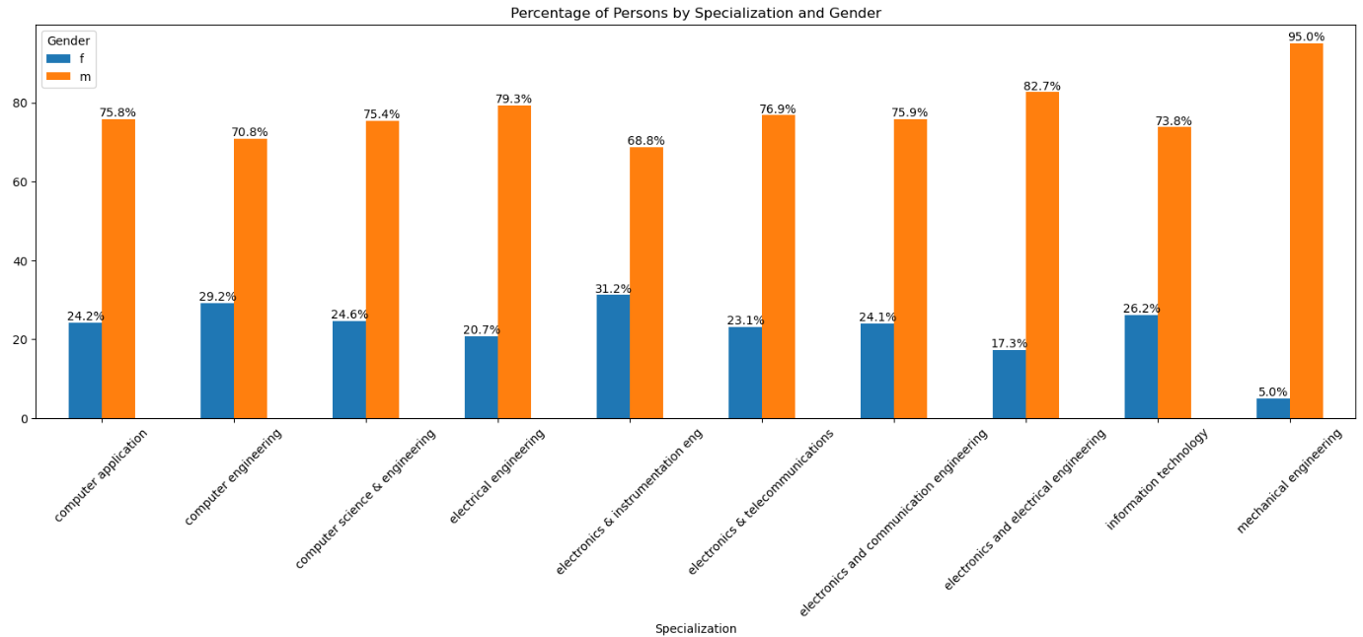
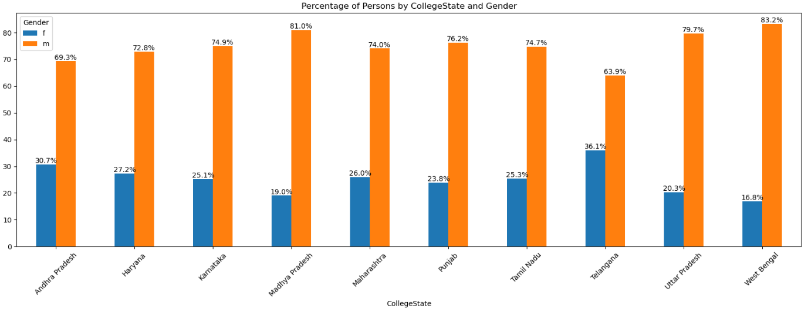
Bivariate analysis (categorical vs categorical)
There is a relationship between gender and CollegeState. Irrespective of specialization male condidates are more than female candidates,
There is a relationship between gender and specilization. Irrespective of specialization male condidates are more than female candidates.

Slide 12
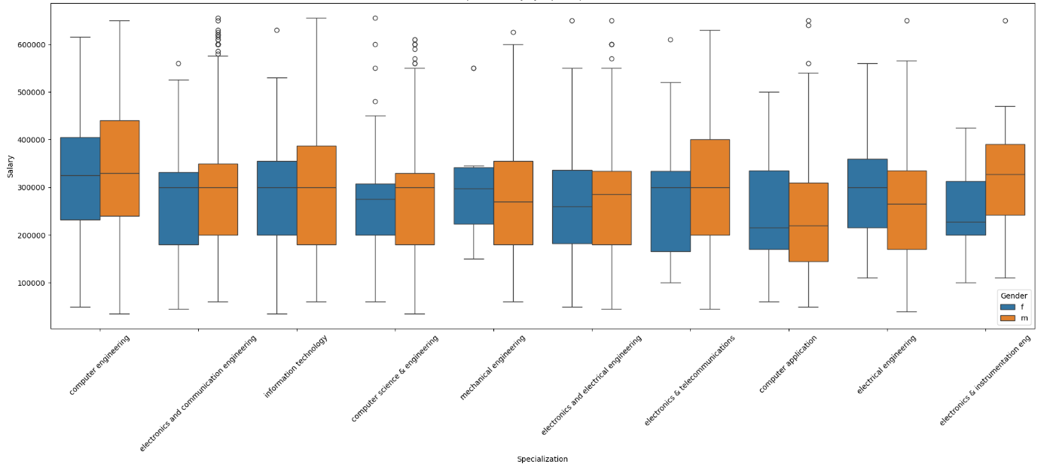
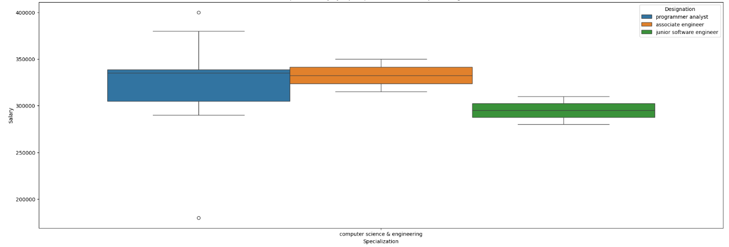
Multivariate analysis
we have data from 2007 to 2014,so for specialization computer science and engineering, salary is between 2.8 to 3.5 lack for Programmer analyst, associate engineer and junior software engineer
There is a relationship between gender, Specialization and salary. Some specialization candidates belongs to male have more salary and some female candidates have more salary

Slide 13
CONCLUSION
After conducting a comprehensive Exploratory Data Analysis (EDA) on the AMCAT dataset, several key insights and trends have been identified. These findings can help in understanding candidate performance, the impact of demographic factors, and areas for potential improvement in the AMCAT testing process. Here are the main conclusions:
Mtech/ME people having more salaries followed by Btech and MCA and MSc.
Male and Female have same range of salaries.
we have data from 2007 to 2014,so for specialization computer science and engineering, salary is between 2.8 to 3.5 lack for Programmer analyst, associate engineer and junior software engineer.
Most of the students are employed as software engineer with 13.5% of total students followed by system engineer and software developer so on.
Most of the students got job in Bangalore followed by Noida and Hyderabad.
Male candidates are more who are employed i.e 76.1% compared with female candidates 23.9%.
Most of the students with Degree Specialization is electronics and communication engineering with 22% followed by computer science and engineering with 18.6%, Information Technology with 16.5%.

Slide 14

THANK YOU

